Slide 1
Understanding Suicide Through Global Data (1985–2016): Trends Across Time, Age, and Development
Eric Ekman
Data 612
12/2/2025
Notes:
Today I’ll present a data-driven exploration of global suicide trends from 1985 to 2016, focusing on how rates vary across gender, age, and indicators of national development. I’ll be analyzing long term trends and testing whether broader societal indicators like GDP and the Human Development Index can help explain suicide patterns over time.

Slide 2
Introduction
Suicide is a global public health concern, yet its causes are complex and multi-determined.
This project uses global data from 1985 to 2016 to explore how suicide rates vary by time, age, gender and development.
Objective: Analyze long term trends and whether broader societal indicators (GDP, HDI) can help explain suicide patterns
Notes:
Suicide is a global public health concern, yet its causes are complex and multi-determined. While some countries have seen declining rates, others, like the U.S., show a troubling rise, particularly among men and middle-aged adults. This project uses global data from 1985 to 2016 to explore how suicide rates vary by time, age, gender and development. The objective of this project is to analyze long-term trends and test whether broader societal indicators help explain suicide patterns across countries and over time.

Slide 3
Methodology
Data Sources: This dataset compares socio-economic information with suicide rates by year and country, with 30 years of data (1985 – 2016).
It is compiled from four other datasets published by the United Nations Development Program, World Bank, and World Health Organization.
Tools: RStudio, tidyverse, regressions, trend plots
Notes:
This dataset compares socio-economic information with suicide rates by year and country, with 30 years of data. It is compiled from four other datasets published by the United Nations Development Program, World Bank, and World Health Organization. I used RStudio with the tidyverse package to clean, visualize, and analyze the data. Line plots were used to explore trends, and linear regression models tested associations between suicide rates and societal indicators over time.

Slide 4
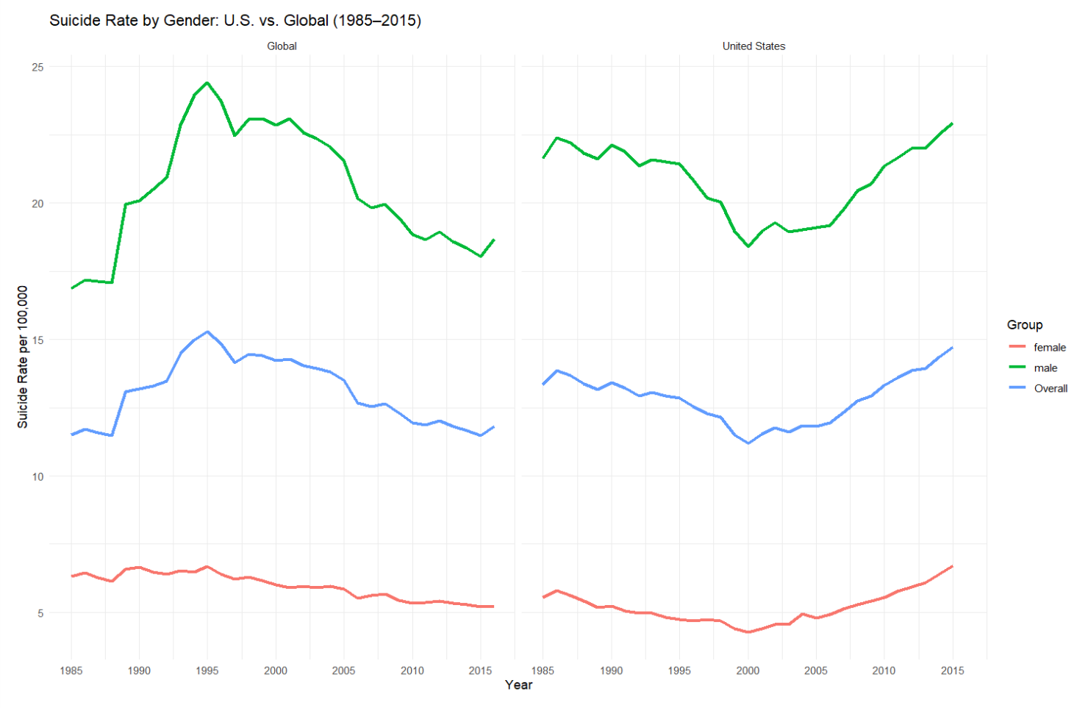
US vs Global Suicide Trends by Year and Gender
Notes:
The first graph compares Global and US suicide rates by gender over a 30 year period. The global male suicide rate peaked in the mid-1990s and declined, while U.S. male rates have risen sharply since 2000. Female rates remain lower than male rates everywhere but show a slight increase over time in the U.S. The U.S. overall suicide rate has diverged from the global decline, especially post-2000—suggesting potential country-specific factors are likely influential.

Slide 5
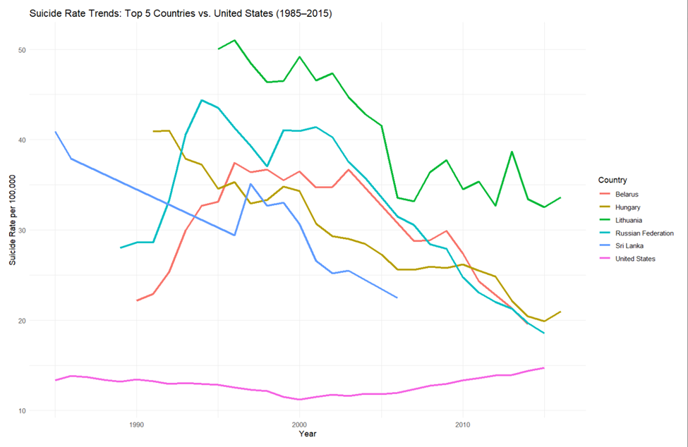
Suicide Rate Trends Top 5 Countries vs US
Notes:
This next graph shows how the countries with the top 5 highest suicide rates compare to the United States.
While the top 5 countries had much higher suicide rates in the 1980s - 1990s, many of these countries have experienced a sharp and consistent decline over time.
The United States, while starting at a much lower rate, is one of the only countries on this chart with a rising trends from ~2000 onward. This makes the U.S. an outlier not in level, but in trajectory, which is possibly more concerning.

Slide 6
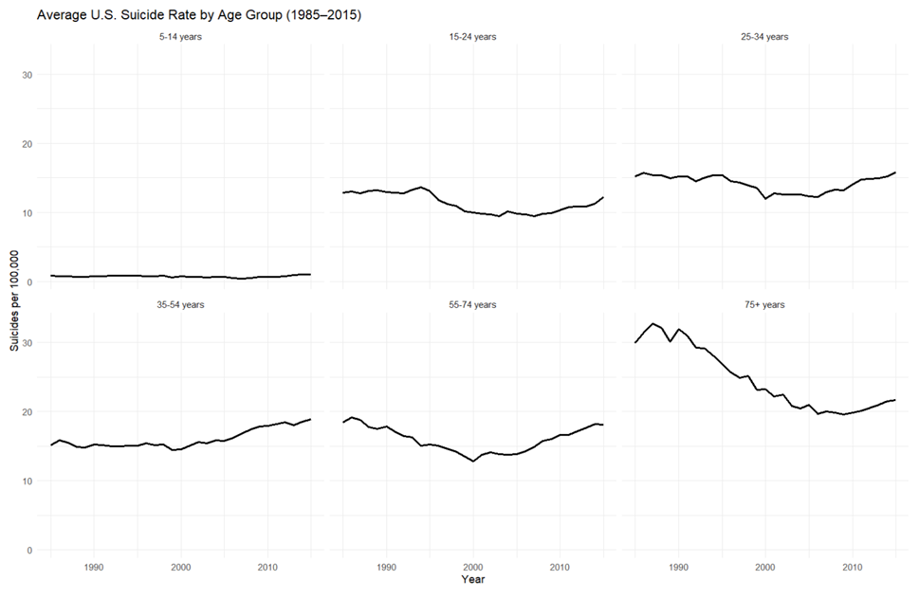
Suicide Rate Trends by Age Group (US)
Notes:
This chart breaks down U.S. suicide trends by age group. The most notable increases since the early 2000s are in the core working-age population (those from 25-74). Youth suicide rates (15–24) also appear to be rising again after a dip in the early 2000s. Meanwhile, older adults (75+) show a long-term decline, and rates among children (5–14) remain low and flat. These trends highlight that recent increases are not universal across all age groups but concentrated in adults and young people.

Slide 7
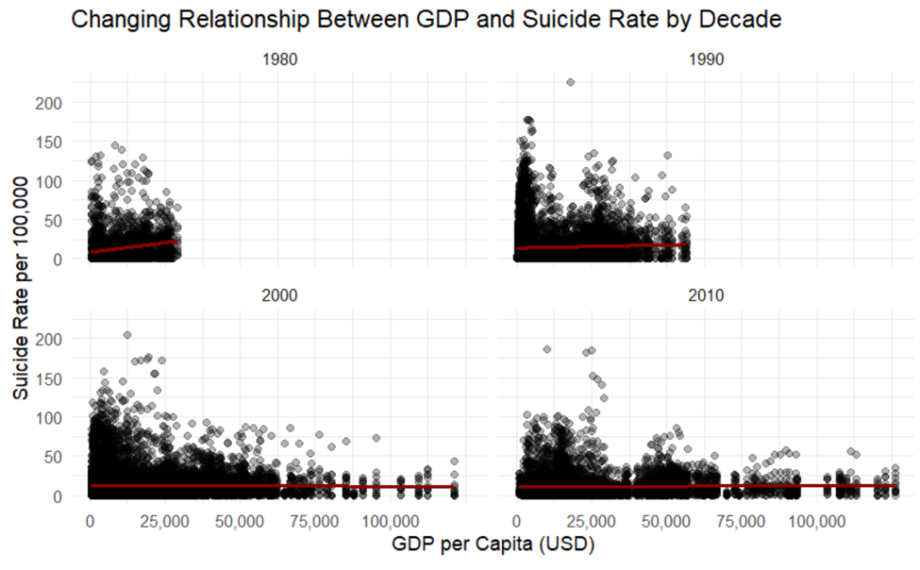
GDP and Suicide Rate
A multiple linear regression tested whether GDP per capita and year predicted suicide rates (per 100,000 people), including their interaction. The model was significant, F(3, 27816) = 44.59, p < .001, with a small effect size (R² = .0048).
Notes:
The first potentially explanatory variable in this dataset is GDP, which stands for gross domestic product. This is the total market value of all finished goods and services produced within a country's borders during a specific period. This is considered a key indicator of a nation's economic health and is used by policy makers to measure economic size and growth.
A multiple linear regression found a statistically significant relationship between GDP and suicide rates; however, it’s a weak effect, only explaining 0.48% of the variance in suicide rates, and the effect has been weakening over time. The weakening of the interaction between GDP and year could reflect global development, better access to healthcare, or more nuanced relationships between a country's economic development and suicide rates.

Slide 8
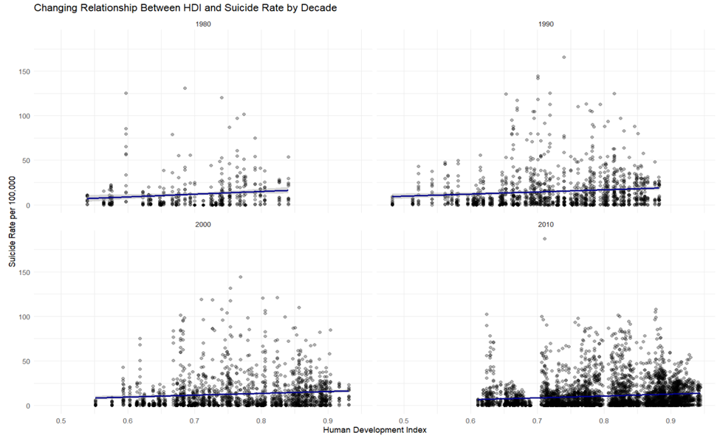
Human Development Index (HDI) and Suicide Rate
A linear regression was conducted to examine the association between Human Development Index (HDI), year, and their interaction on suicide rates. The overall model was significant, F(3, 8360) = 53.23, p < .001, with an adjusted R² = .018.
Notes:
Next, let's look at a more robust measure of human development. The human development index (HDI), is a composite statistic that measure a country's average achievement in life expectancy, education, and a decent standard of living. While GDP focuses purely on economic activity, the HDI provides a broader picture of a nation's development.
A multiple linear regression was conducted to examine the association between Human Development Index (HDI), year, and their interaction on suicide rates.
HDI had a slightly stronger, but still modest relationship with suicide rates, explaining 1.8% of the variance in suicide rates. Like GDP, its predictive power has also declined over time. This could reflect rising suicide rates in lower-development countries or stabilizing rates in high-development countries.

Slide 9
Conclusions and Recommendations
Neither GDP or HDI emerged as strong predictors of suicide rates globally, reflecting the multi-determined nature of suicide
This reinforces the need for multi-level, interdisciplinary approaches
Notes:
Despite examining economic and development indicators like GDP and HDI, neither emerges as a strong predictor of suicide rates globally. The variability across age, gender, and national trends suggests that suicide is not rooted in any single societal metric but instead reflects the outcome of a constellation of psychological, social, and structural factors.
This reinforces the need for multi-level, interdisciplinary approaches, not only data-driven but also human-centered, to understand and prevent suicide.

Slide 10
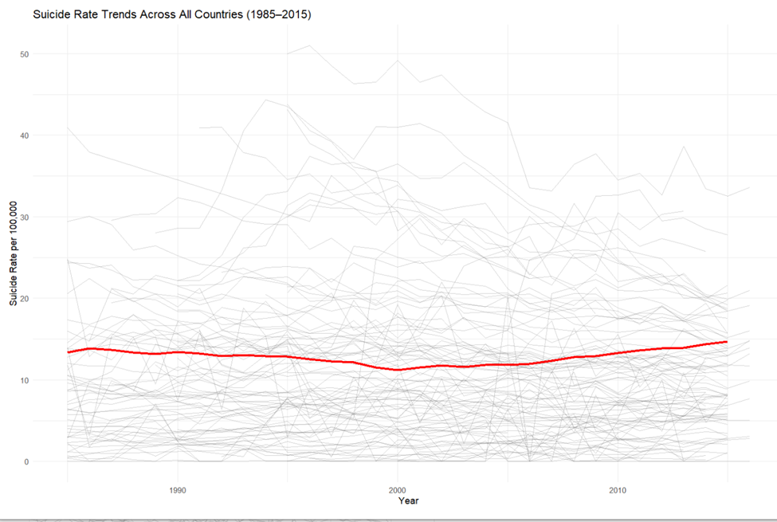
Suicide Rate Trends Across All Countries (1985-2015)
Notes:
To provide another visualization, the red line shows the US trend line while the grey lines show all other countries.

